Slide 1
Brag Board(Employee Recognition and Achievement Platform)
Brag Board is a web-based internal platform designed to help organizations recognize and showcase employee achievements in a structured and transparent way. It focuses on providing a centralized system where employee accomplishments can be stored, viewed, and managed efficiently within the organization.
During my internship, I worked on building the initial version of this platform by setting up both backend and frontend foundations. The work carried out in Week 1 and Week 2 focused on creating a stable architecture that can be enhanced with additional features in later phases.

Slide 2
Project Introduction
In many organizations, employee achievements such as certifications, awards, and successful project completions are spread across emails, spreadsheets, or internal messages. This makes tracking and recognition difficult and inconsistent across teams.
Brag Board aims to solve this problem by providing a single digital platform where achievements can be recorded and accessed easily. This helps improve transparency, employee motivation, and structured recognition within the organization.

Slide 3
Project Overview
Brag Board is designed as a full-stack web application with a clear separation between backend services and frontend interface. The backend is responsible for handling data storage, logic, and secure communication with the database.
The frontend provides a user-friendly interface that allows users to interact with the system. This separation ensures better maintainability, scalability, and smoother future enhancements.

Slide 4
Tools & Technologies Used
Backend Tools: Python, FastAPI for API development, SQLAlchemy for database interaction, PostgreSQL as the relational database, and Uvicorn as the backend application server.
Frontend Tools: React.js for building the user interface, Vite as the development and build tool, HTML, CSS, JavaScript for structure and logic, Tailwind CSS for styling, and Node.js with npm for dependency management.

Slide 5
Week 1 – Backend Development And Implementation
Week 1 was dedicated to setting up the backend architecture of the Brag Board application. This included creating the project structure, configuring the development environment, and preparing the backend to run independently.
The main objective during this phase was to ensure that the backend services could connect to the database, expose APIs, and remain stable for further development and frontend integration.
FastAPI was used to implement REST APIs, and SQLAlchemy was configured to manage database operations efficiently. Environment variables were used to store sensitive configuration details securely.
All APIs were tested using Swagger UI to verify correct request and response behavior. The backend server was successfully run using Uvicorn, confirming proper backend functionality.

Slide 6
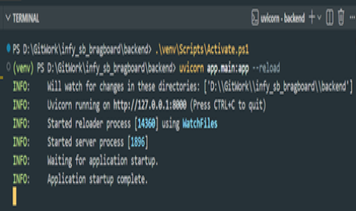
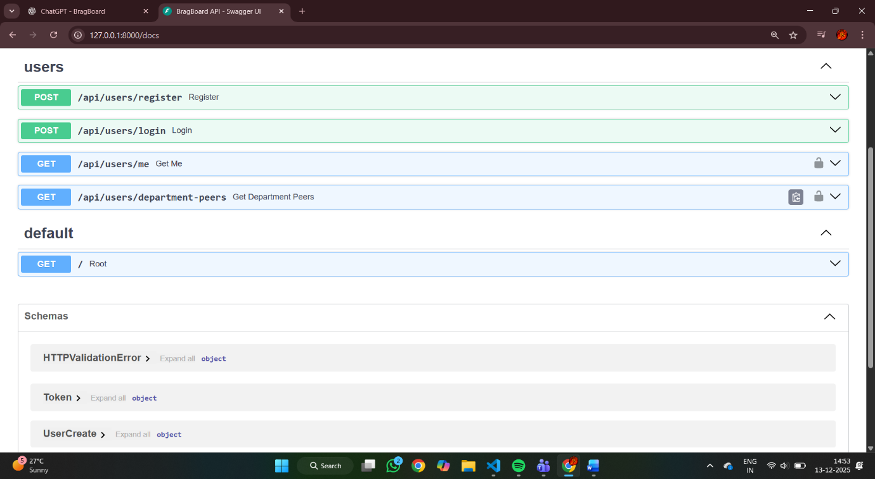
Snapshots of Backend
Backend running in terminal
Swagger UI testing

Slide 7
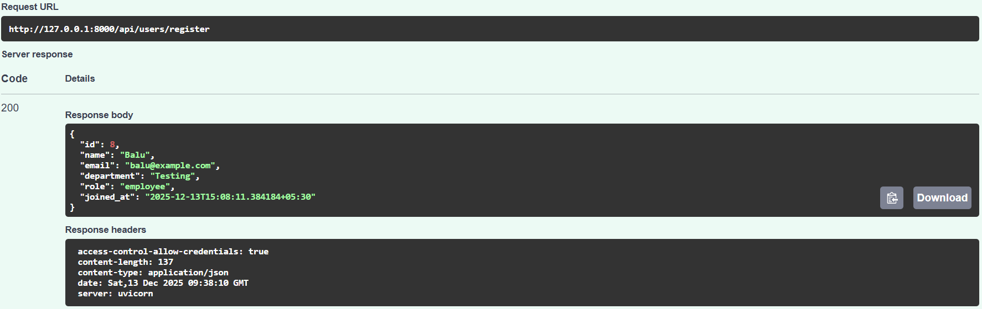
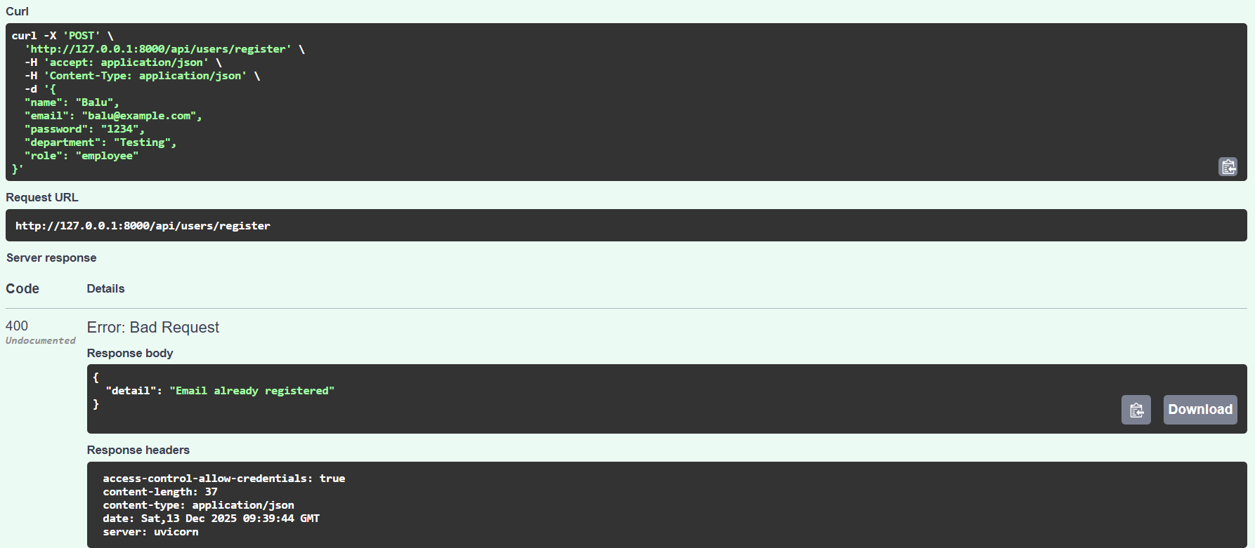
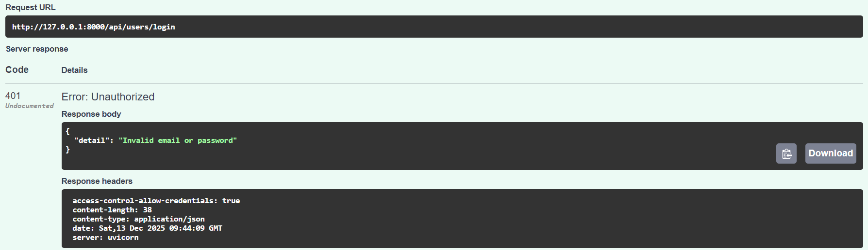
Database Integration & Validation
PostgreSQL was integrated as the main database for the application. SQLAlchemy ORM models were used to define database tables and manage data interactions. Basic validation was performed to confirm successful data storage and retrieval. This ensured that the backend database layer was fully functional and ready for frontend connectivity.

Slide 8
Week 2 – Frontend Development and Implementation
Week 2 focused on setting up the frontend environment using React with Vite. The project structure was created to support scalable UI development and future API integration.
The goal of this phase was to establish a clean and organized frontend foundation that could communicate with backend services in the next stage.
Tailwind CSS was configured to provide consistent and responsive styling across the application. Core UI components and layout structure were prepared during this phase.
The frontend development server was launched successfully, and pages were rendered in the browser, confirming correct setup and functionality.

Slide 9
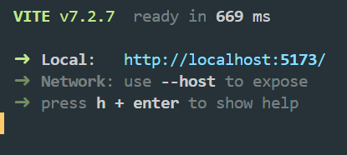
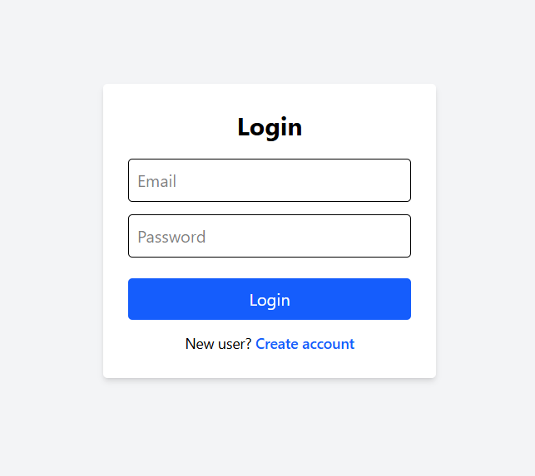
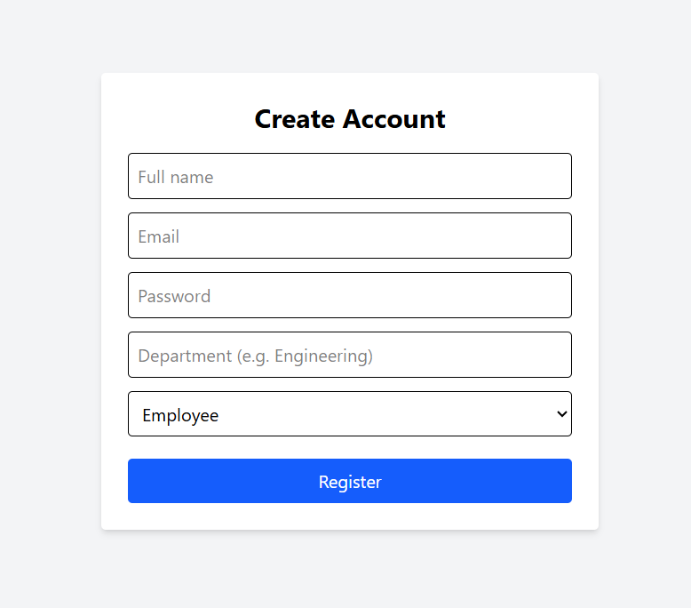
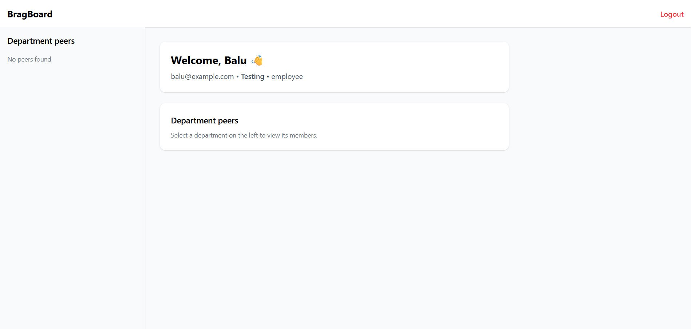
Snapshots of Frontend

Slide 10
Conclusion & Next Steps
By the end of Week 2, the foundational setup of both backend and frontend was completed successfully. The backend provides stable APIs with database support, while the frontend delivers a responsive user interface.
In the next phase, backend APIs will be integrated with the frontend, authentication will be implemented, and additional features will be developed to enhance the Brag Board platform.

